Slide 1


Analysis of the Categories for Social Buzz
By Vaishnevi Priya P : v1-01032024

Slide 2


Today's agenda
Project recap
Problem
The Analytics team
Process
Insights
Summary

Slide 3

Our engagement with Social Buzz, we are running a 3 month initial project . They are expecting the following:
They are still a small company and do not have the resources to manage the scale that they are currently at and want an experienced practice to help , and so we come into the picture.
* An audit of their big data practice
* Recommendations for a successful IPO
* An analysis of their content categories that highlights the top 5 categories with the largest popularity
Project Recap

Slide 4


Every day over 100,000 pieces of content, ranging
from text, images, videos and GIFs are posted They want an analysis of their content categories to highlight the top 5 categories based on popularity
Problem
Notes:
An audit of their big data practice
Recommendations for a successful IPO
An analysis of their content categories that highlights the top 5 categories with the largest popularity

Slide 5



Andrew Fleming
Chief Technical Architect
The Analytics team
Marcus Rompton
Senior Principle
Myself
Data Analyst
Notes:
Andrew Fleming (Chief Technical Architect), Marcus Rompton (Senior Principle), and Myself (Data Analyst)!

Slide 6
Data collection and Understanding
Process
1
Data Cleaning
2
Data Modelling
3
Data Analysis For Solution
4
5
Insights From Data
Notes:
Collected the Datasets
Cleaning the data from all the excels by removing the missing values,removing the unwanted columns,halding incorrect data and removing the duplicates – Content, Reaction and Reaction Type
Merging the datasets. All the excel wrt the contentID
Finding the total scores for each category of the content
Fetching the top 5 categories based on the sum of total scores for that particular category.

Slide 7

Insights
16
1897
JANUARY
UNIQUE CATEGORIES
REACTIONS TO "ANIMAL" POSTS
MONTH WITH MOST POSTS
Notes:
From the data we found that you had a total of 16 unique categories of posts across your sample dataset. This includes things such as Food, Culture and Sport.
As well as this, there were 1897 reactions from just the animal category alone! People obviously really like animals!
And also the most common month for users to post within was January. This aligns with seasonal trends of social media users that feel the need to reconnect with people after calendar events such as Christmas and new year.

Slide 8
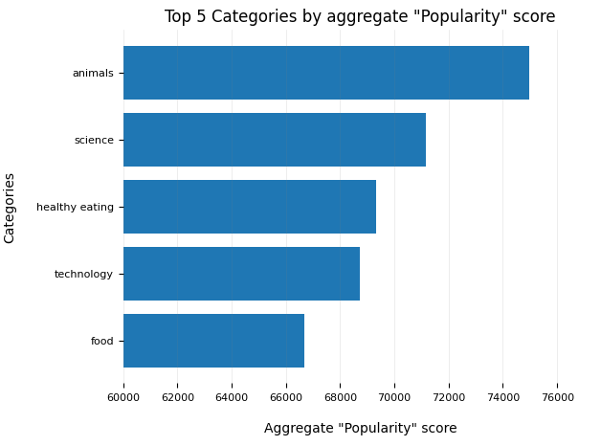
Notes:
From our analysis, you can see that the top 5 most popular categories of posts were animals, science, healthy eating, technology and food in descending order.
Animals had an aggregate popularity score of around 74965. It is very interesting to see both food and healthy eating within the top 5, it really shows that food is a highly engaging content category. Healthy eating ranks slightly higher than food, so perhaps your user base may be skewed towards healthy eaters and health-conscious people.

Slide 9
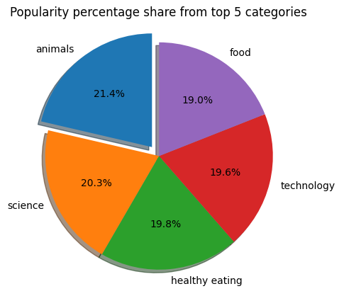
Notes:
Additionally, you can see from this chart the % split of popularity between the top 5 categories. There is not much difference between the share of each category, however, the difference between the 1st most popular, animals and the 2nd most popular, science, is the largest gap equal to 1.1%.
In business terms, this could suggest that the most popular category, animals, is tailing away from the rest of the categories and may continue to get more and more popular. To avoid an issue where 1 content category consumes the entire platform, it will be important for you to ensure that any algorithms used to govern the content on the platform gives a fair balance to the content categories.

Slide 10

Summary
animals
science
healthy eating
technology
food
ANALYSIS:
The top 5 categories are: Animals, Science, Healthy eating,Technology,Food
ACTION:
This ad-hoc analysis is insightful, but it's time to take this analysis into large scale production for real-time understanding of your business. We can show you how to do this.
Notes:
So to summarize:
We tackled this task and found the top 5 most popular categories as asked, but we also went one step further.
- We found that animals and science are the two most popular categories, suggesting that users like "real-life" and "factual" content
- We also found that food was a common theme amongst popular content and the most popular food category was healthy eating. This could be a signal to show the types of people that are using your platform, and you could use this insight to boost engagement even further. For example, you could run a campaign with content focused on this category or work with healthy eating brands to promote content.
- As much as this analysis was insightful, we are ready to take it to the next stage and we have the expertise within Accenture to help you realize these kinds of insights in production across your organization and in real-time. We would love to help you with this.

Slide 11
Thank you!
ANY QUESTIONS?

